Slide 1
Suicidal Ideation Detection Using Text GCN
Prepared by:
Sunil Sharanappa

Slide 2
contents
Background
Problem Statement
Literature Review
Aim & Objectives
Methodology
Dataset
Exploratory data analysis (EDA)
Model Building
Results & Discussion
Conclusion & Future Works

Slide 3

Background
Suicide is 4th most cause of Death as per WHO
Causes of Suicide are:
Depression
Worry
Impulsivity
Unpleasant life experience
Previous Suicide attempt
Prevention of Suicide is Worldwide Community Health Goal
Since increase in social media platform People express their Pain, sentiments and suicidal intentions.
As a Result, online Social Media have become Screening Tool for suicidal ideations.
Early Detection of suicidal thoughts can help people and create a consultation portal where social worker or psychiatrist or family members can help to overcome
Image Credit:gateway2counseling

Slide 4

Problem Statement
Availability of free available labelled Dataset
Online prediction of suicidal ideation is not common and suicidal ideation signs needs to be manually recognized by peers or family.
On online social platform people are expressive and shares there feeling most of the time before they take any extreme steps
Just 1% increase in accuracy of correctly predicting the suicidal Ideation can save hundreds of lives
Tradition models fails to extract contextual,syntatics or pragmatic features
Image Credit:-Sprc org

Slide 5
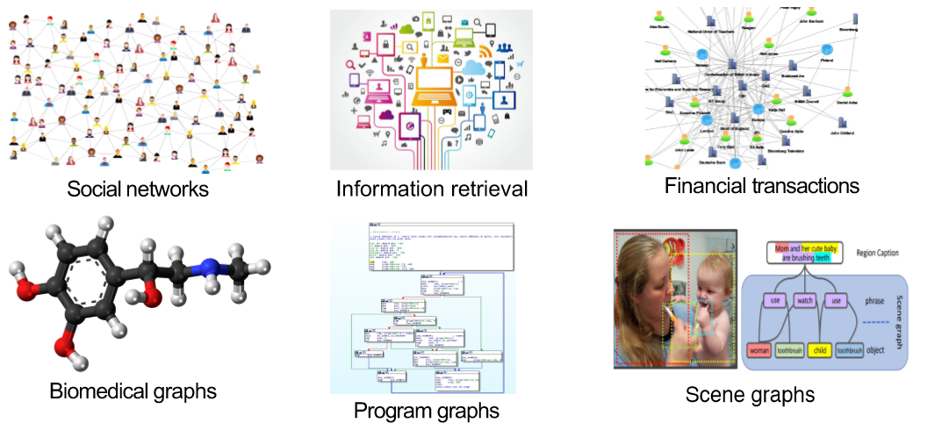
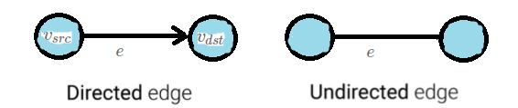
Literature Review
Graph Usages in the Real world
Types of Graphs present
Components required to Create Graph
Representation of Encoder & Decoder on Graph data
CNN vs Graph GCN
Normalizing Feature nodes
Text GCN
Graph usage
Types of Graph

Slide 6
Aim & Objectives
To study the feasibility of using Text GCN on social media corpus
To assess effect of the size of the target data with different sizes of the training data against traditional models.
To evaluate the results by varying window size, embedding dimensions, dense layers, drop out and learning rates and compare the results with traditional classification models

Slide 7
Methodology
Data Reading & Inspection
EDA
Word length check
Model Building
Graph Construction
Graph convolution Neural network
Logistic Regression
Model Evaluation & Comparison
Conclusion & Recommendations
Accuracy
Import Data Set
Data Imbalance Check
Frequency count
Loss
Model Output
Data Pre-processing
Word cloud

Slide 8
Dataset
Dataset properties
Collection of posts from “depression" and “SuicideWatch" of the reddits platform
All the posts are extracted through push shift API from Dec 16,2008 till Jan 2,2021
Data has 2 labels “text” and “label”, text contains corpus and label contains whether text is suicidal or non-suicidal
data preparation
Data preprocessing
Removing Null Values
Removing Data Duplication
Removing Junk or special characters
Removing extra spaces

Slide 9
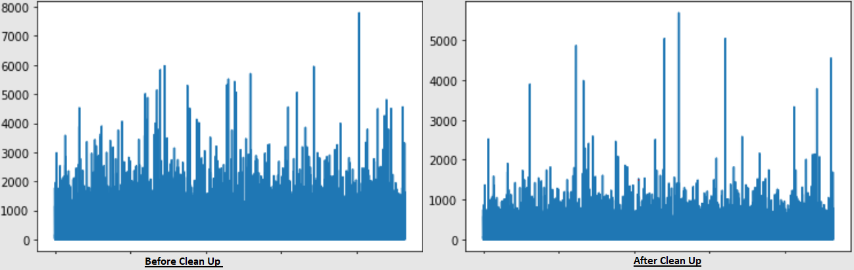
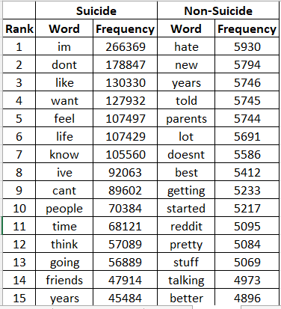
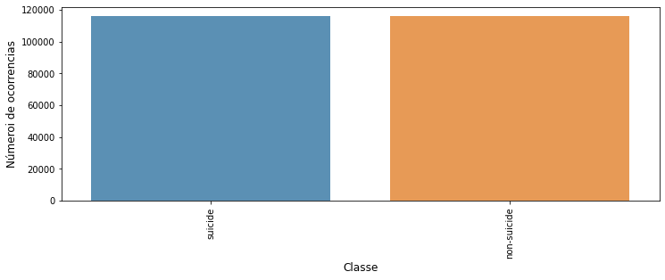
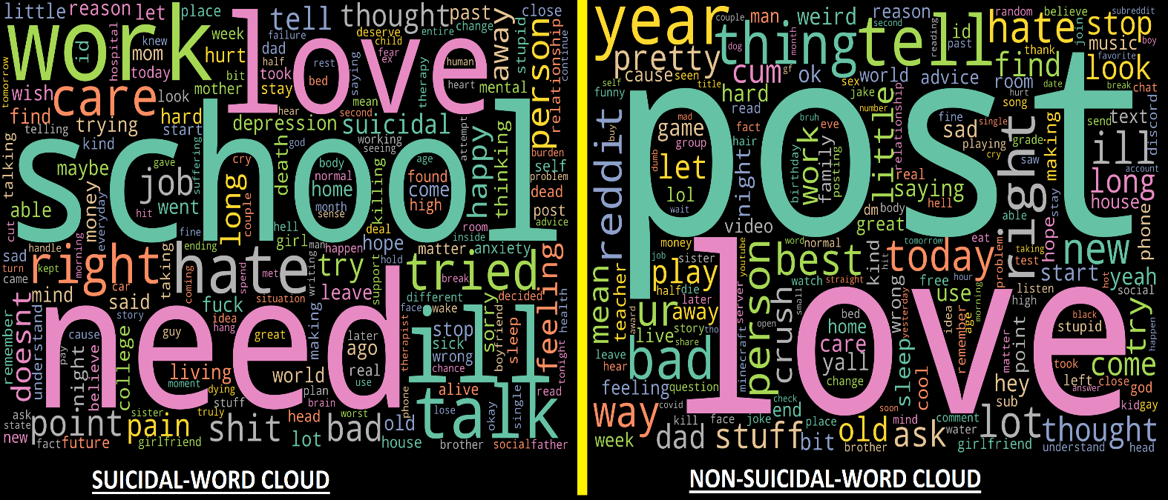
Exploratory data analysis (EDA)
DATA IMBALANCE CHECK
There is no data imbalance in the given dataset as seen in the bar chart.
WORD LENGTH BEFORE & AFTER CLEANUP
We plotted the word length of each sentences before and after clean up and we can see the change the word length.
We also listed out Top 15 rank words under both suicidal and non-suicidal text
INFERENCE FROM WORDCLOUD
In the word cloud we were clearly able to see positive words in non-suicidal text and negative words in suicidal text

Slide 10
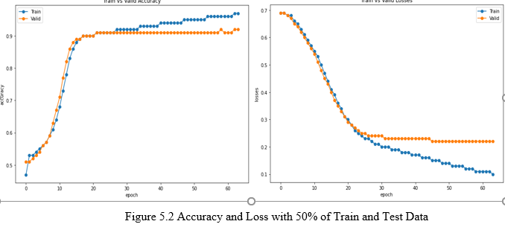
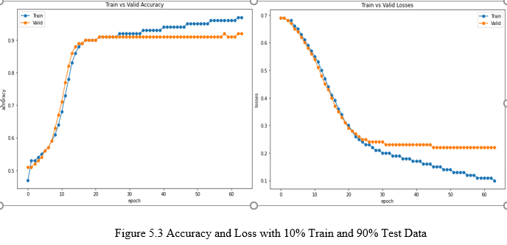
Model Building - 1
Evaluation of the Model Varying the Volume of Train Size
Perc of Train & Test split (Train %|| Test %) | Text corpus size | Training data | Test Data | window size | Learning Rate | Embedding Dim | Training accuracy | Training loss | Val accuracy | Val loss | Test accu | Test loss | Precision | Recall | F1-Score
50% || 50% | 231973 | 115000 | 116973 | 15 | 0.02 | 300 | 0.9506 | 0.13929 | 0.92617 | 0.18442 | 0.92803 | 0.18868 | 0.9291 | 0.928 | 0.928
50%||50% | 115000 | 57500 | 57500 | 15 | 0.02 | 300 | 0.94778 | 0.1472 | 0.91946 | 0.21421 | 0.92388 | 0.19789 | 0.9244 | 0.9238 | 0.9238
10%||90% | 231973 | 23197 | 208776 | 15 | 0.02 | 300 | 0.96633 | 0.10378 | 0.91548 | 0.22016 | 0.92105 | 0.20522 | 0.922 | 0.921 | 0.921
20%||80% | 231973 | 46394 | 185579 | 15 | 0.02 | 300 | 0.96094 | 0.11687 | 0.92197 | 0.20117 | 0.9251 | 0.1964 | 0.9258 | 0.9251 | 0.9251

Slide 11
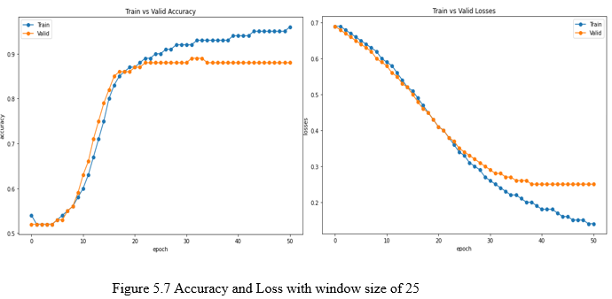
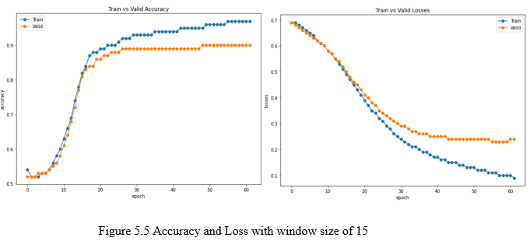
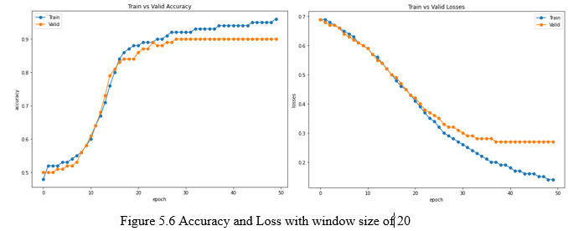
Model Building - 2
Evaluation of the Model Varying the Window Size
Perc of Train & Test split (Train %|| Test %) | Text corpus size | Training data | Test Data | window size | Learning Rate | Embedding Dim | Training accuracy | Training loss | Val accuracy | Val loss | Test accu | Precision | Recall | F1-Score
40%||60% | 10000 | 4000 | 6000 | 10 | 0.01 | 300 | 0.95503 | 0.13288 | 0.9225 | 0.25868 | 0.89547 | 0.8956 | 0.8958 | 0.8955
40%||60% | 10000 | 4000 | 6000 | 15 | 0.01 | 300 | 0.97474 | 0.09286 | 0.9025 | 0.23528 | 0.8953 | 0.8956 | 0.8957 | 0.8953
40%||60% | 10000 | 4000 | 6000 | 20 | 0.01 | 300 | 0.95586 | 0.13839 | 0.9025 | 0.26771 | 0.89664 | 0.8973 | 0.8972 | 0.8966
40%||60% | 10000 | 4000 | 6000 | 25 | 0.01 | 300 | 0.95586 | 0.13941 | 0.8825 | 0.25077 | 0.89464 | 0.8948 | 0.895 | 0.8946

Slide 12
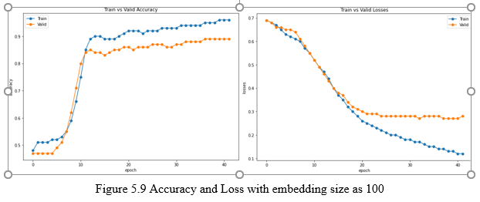
Evaluation of the Model varying the Embedding size
Model Building - 3
Perc of Train & Test split (Train %|| Test %) | Text corpus size | Training data | Test Data | window size | Learning Rate | Embedding Dim | Training accuracy | Training loss | Val accuracy | Val loss | Test accu | Precision | Recall | F1-Score
40%||60% | 10000 | 4000 | 6000 | 15 | 0.02 | 300 | 0.94003 | 0.16894 | 0.8825 | 0.29071 | 0.8881 | 0.8906 | 0.8891 | 0.8881
40%||60% | 10000 | 4000 | 6000 | 10 | 0.02 | 600 | 0.92865 | 0.19147 | 0.8875 | 0.34576 | 0.8943 | 0.8953 | 0.895 | 0.8943
40%||60% | 10000 | 4000 | 6000 | 10 | 0.02 | 100 | 0.95947 | 0.11606 | 0.89 | 0.27524 | 0.8953 | 0.8957 | 0.8958 | 0.8953

Slide 13
Model Building - 4
Comparison of Traditional model against Text GCN with the Volume of Train Data
Perc of Train & Test split (Train %|| Test %) | Text corpus size | Training data | Test Data | window size | Learning Rate | Embedding Dim | Training accuracy | Training loss | Val accuracy | Val loss | Test accu | Precision | Recall | F1-Score
10%||90% | 231973 | 23197 | 208776 | 15 | 0.02 | 300 | 0.96633 | 0.10378 | 0.91548 | 0.22016 | 0.92105 | 0.922 | 0.921 | 0.921
10%||90% | 231973 | 23197 | 208776 |  |  |  |  |  |  |  | 0.86 | 0.86 | 0.86 | 0.86

Slide 14
Results & Discussion
This work demonstrated the efficacy of Text GCN with relatively less training data.
We had some limitations when working with the Text GCN
The first issue we ran into was overload on RAM since we had huge corpus and constructing with different window size lead to some processing delays with our 12GB google colab plus RAM.
Another limitation we faced is GCN neural network algorithms require a lot of GPU power Due to the limited availability of GPUs, thorough training for deep learning algorithms was limited

Slide 15
Conclusion & Future Works -01
We were able to list out common emotional words which are part of Suicidal Ideation text
We were able to see some major patterns like Desire, People topic & State of Mind or Body in the Suicidal ideation corpus
Text GCN performs better compared to traditional model since graph is made of word-word and doc-word nodes which carries contextual information compared to traditional models
Text-GCN performs very well even with less Volume of train data even training the model with 10% gives better result compared to traditional Machine learning algorithms.

Slide 16
Conclusion & Future Works -02
FUTURE WORKS:-
Due to the time and hardware resource constraint, we refrained using multiple dense layers and refrained to only 2 hidden layers however using multiple dense layer can improve the performance if used in the future
We recommend to explore different word embeddings and different embedding dimensions to construct sparse matrix to see how well they work also we also recommend to explore pre-trained embeddings such glove to construct graphs

Slide 17
“thank you…

